Slide 1
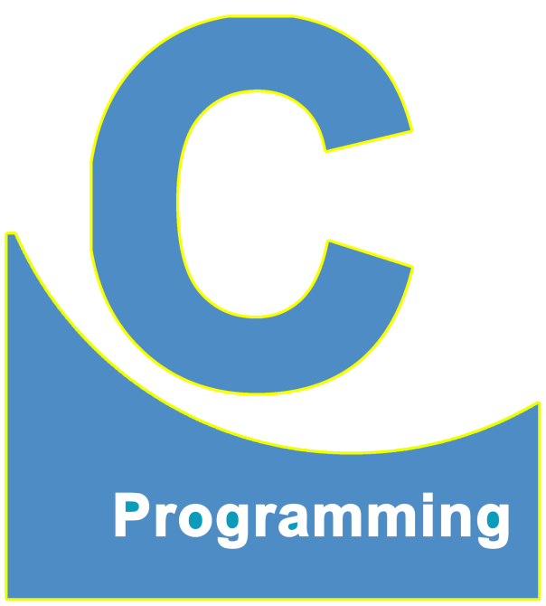
01
02
C Language
Lecture 25
04

Slide 2


Today’s Agenda
01
Shorthand Operators
02
Some Example

Slide 3
Using Shorthand Operator
int main()
{
int i = 1;
while(i <= 10)
{
printf("%d\n", i);
i = i + 1; //Increment by 1
}
return 0;
}
You can increment a value of a variable in 4 different ways
1. i = i + 1;
2. i += 1;
3. i++;
4. ++i;

Slide 4
Examples of Shorthand Operators
1. a = a + 10;
or
a += 10;
2. x = x - y;
or
x -= y;
3. i = i / j;
or
i /= j;
4. k = k * j;
or
k *= j;
5. n = n % x;
or
n %= x;
a += 10;--->This is transformed by compiler into--->a = a + 10;
x -= y;--->This is transformed by compiler into--->x = x - y;

Slide 5
Also Know!
+=
-=
*=
/=
%=
Short Hand Operator
or
Compound Operator
or
Arithmetic Assignment Operator

Slide 6
Example of Shorthand Operators
int main()
{
int a = 10;
a = a + 1; //This can also be written as
printf("%d", a);
return 0;
}
a = a + 1;--->a++;
or
a = a + 1;--->++a;
a++;--->This is transformed by compiler into--->a = a + 1;
++a;--->This is transformed by compiler into--->a = a + 1;

Slide 7
Don't get confused
a = b + c + d; //No Shortcut
a += b + c; --->Can be written as---> a = a + b + c;
a =+ 1; --->This will be---> a = 1;
a += 1; --->This will be---> a = a + 1;

Slide 8
Increment Operator
There are two types of Increment Operator
1. Post Increment Operator(When ++ is used after Variable)
2. Pre Increment Operator(When ++ is used before Variable)
a++; is called as Post Increment
++a; is called as Pre Increment
++ Unary Increment Operator
This will increment the value of a variable by 1 only not 2 or nor 3

Slide 9
Important Point
They serve the same purpose when they are used as a single expression.
But their behavior will be changed when they used as an expression
containing assignment operator
a++; and ++a; they both are same for the compiler
But, b = a++; is different from b = ++a;

Slide 10
Let's Discuss
a = 10;
b = a++;
This will be evaluated by the compiler in the following steps
b = a++; \\will be evaluated in the following 2 steps
1. b = a;
i.e.
b = 10;
2. a++;
i.e.
a = a + 1;
a = 10 + 1;
a = 11;
So, the final value of b will be 10 and the final value of a will now become 11

Slide 11
Let's Discuss
a = 10;
b = ++a;
This will be evaluated by the compiler in the following steps
b = a++; will be evaluated in the following 2 steps
1. ++a;
i.e.
a = a + 1;
a = 10 + 1;
a = 11;
2. b = a;
i.e.
b = 11;
So, the final value of b will be 11 and the final value of a will now become 11

Slide 12
Examples of Pre/Post Increment
GUESS THE OUTPUT
int main()
{
int x = 2, y, z;
y = x++;
z = ++x;
printf("x = %d, y = %d, z = %d", x, y, z);
return 0;
}
OUTPUT
x = 4, y = 2, z = 4
Process returned 0 (0x0) execution time : 0.085 s
Press any key to continue.

Slide 13
Examples of Pre/Post Increment
GUESS THE OUTPUT
int main()
{
int x = 2, y, z;
y = ++x;
z = x++;
printf("x = %d, y = %d, z = %d", x, y, z);
return 0;
}
OUTPUT
x = 4, y = 3, z = 3
Process returned 0 (0x0) execution time : 0.098 s
Press any key to continue.

Slide 14
Order of Evaluation
Pre-Increment Operator
2. Arithmetic Operators
3. Assignment Operator
4. Post Increment Operator

Slide 15
Examples of Pre/Post Increment
GUESS THE OUTPUT
int main()
{
int a, b = 10, c = 5;
a = b + c++;
printf("a = %d, b = %d, c = %d", a, b, c);
return 0;
}
OUTPUT
a = 15, b = 10, c = 6
Process returned 0 (0x0) execution time : 0.085 s
Press any key to continue.

Slide 16
Examples of Pre/Post Increment
GUESS THE OUTPUT
int main()
{
int a, b = 10, c = 5;
a = b + ++c;
printf("a = %d, b = %d, c = %d", a, b, c);
return 0;
}
OUTPUT
a = 16, b = 10, c = 6
Process returned 0 (0x0) execution time : 0.085 s
Press any key to continue.

Slide 17
Examples of Pre/Post Increment
GUESS THE OUTPUT
int main()
{
int a, b = 10, c = 5;
a = b++ + c++;
printf("a = %d, b = %d, c = %d", a, b, c);
return 0;
}
OUTPUT
a = 15, b = 11, c = 6
Process returned 0 (0x0) execution time : 0.085 s
Press any key to continue.

Slide 18
Special Note!
If we increment or decrement the SAME VARIABLE more than one time in the SAME EXPRESSION then the evaluation/behavior depends on the compiler.

Slide 19
Example
In GCC Compiler
int main()
{
int a, b = 10, c = 5;
a = b++ + c++;
printf("a = %d, b = %d, c = %d", a, b, c);
return 0;
}
OUTPUT
a = 15, b = 11, c = 6
Process returned 0 (0x0) execution
time : 0.090 s
Press any key to continue.
1. Works same on both compiler
In Turbo Compiler
void main()
{
int a, b = 10, c = 5;
clrscr();
a = b++ + c++;
printf("a = %d, b = %d, c = %d", a, b, c);
getch();
}
OUTPUT
a = 15, b = 11, c = 6

Slide 20
Example
Works different on both compiler
In Turbo Compiler
void main()
{
int a, b = 10;
clrscr();
a = b++ + b++;
printf("a = %d, b = %d", a, b);
getch();
}
OUTPUT
a = 20, b = 12
In GCC Compiler
int main()
{
int a, b = 10;
a = b++ + b++;
printf("a = %d, b = %d", a, b);
return 0;
}
OUTPUT
a = 21, b = 12
Process returned 0 (0x0) execution time : 0.102 s
Press any key to continue.
This is Turbo's behavior,
not every compiler’s
behavior

Slide 21
Another example in Turbo Compiler
Guess the output
void main()
{
int a, b = 10;
clrscr();
a = b++ + ++b;
printf("a = %d, b = %d", a, b);
getch();
}
OUTPUT
a = 22, b = 12
void main()
{
int a, b = 10;
clrscr();
a = ++b + ++b + ++b;
printf("a = %d, b = %d", a, b);
getch();
}
OUTPUT
a = 39, b = 13

Slide 22
GCC behavior
for:
Post-Expression: Use the value first and then increment in memory
Pre-Expression: I'll keep on incrementing the value in memory and when the expression finishes then I'll use the value

Slide 23
Another example in GCC Compiler
Guess the output
int main()
{
int a, b = 10;
a = b++ + ++b;
printf("a = %d, b = %d", a, b);
return 0;
}
OUTPUT
a = 22, b = 12
Process returned 0 (0x0) execution time : 0.105 s
Press any key to continue.
int main()
{
int a, b = 10;
a = ++b + b++;
printf("a = %d, b = %d", a, b);
return 0;
}
OUTPUT
a = 23, b = 12
Process returned 0 (0x0) execution time : 0.087 s
Press any key to continue.

Slide 24
Another example in GCC Compiler
Guess the output
int main()
{
int a, b = 10;
a = ++b + ++b + ++b;
printf("a = %d, b = %d", a, b);
return 0;
}
OUTPUT
a = 37, b = 13
Process returned 0 (0x0) execution time : 0.088 s
Press any key to continue.
int main()
{
int a, b = 10;
a = b++ + b++ + ++b;
printf("a = %d, b = %d", a, b);
return 0;
}
OUTPUT
a = 34, b = 13
Process returned 0 (0x0) execution time : 0.106 s
Press any key to continue.

Slide 25
Another example in GCC Compiler
Guess the output
int main()
{
int a, b = 10;
a = ++b + b++ + ++b + ++b;
printf("a = %d, b = %d", a, b);
return 0;
}
OUTPUT
a = 50, b = 14
Process returned 0 (0x0) execution time : 0.175 s
Press any key to continue.

Slide 26
v/s
++ v/s +
Increment Operator
Unary Operator
It always changes the
value of its operand
Arithmetic Addition
Binary Operator
It Never changes the value of the operand

Slide 27
Types of Operators
(Based Upon Number of Operands)
1. Unary Operators(Require Only 1 Operand)
Ex
a++; //one operand i.e. a
or
++a; //one operand i.e. a
2. Binary Operators(Require Exactly 2 Operands)
Ex
a + b; //first operand is "a" and the second operand is "b"
10 + 5; //first operand is "10" and second operand is "5"
a + 10; first operand is "a" and second operand is "10"
3. Ternary Operator(Require 3 Operands)
C has only 1 ternary operator and that is "?"-":"

Slide 28
Note
1. = Assignment Operator Binary Operator
2. & Address of Operator Unary Operator
3. && Logical AND Binary Operator
4. + Arithmetic Addition Binary Operator
5. % Modulo Division Operator Binary Operator
6. - Minus/Negation Unary Operator
7. ?: Conditional Operator Ternary Operator

Slide 29
Do you Know?
int a;
a = -5;
//Only one operand i.e. "5"
int a;
a = 10 - 5; //our code
i.e.
10 + (-5) //Compiler's Understand
//Only one operand i.e. "5"

Slide 30
Guess the output of the following code
1.
int a, b = 10;
a = b++;//a = 10, b = 11
2.
int a, b = 10;
a = ++b;//a = 11, b = 11
3. int a, b = 10;
a = b + 1;//a = 11, b = 10

Slide 31
Important Point
Similar to ++, C language also provides us --, and this operator also has 2 versions:
1. Post Decrement: i--
2. Pre Decrement: --I
An important point to remember about ++ and --
In C language, there is a very important guideline which programmers must follow and the
guideline says that we should never increment or decrement the value of the same variable
more than one time in a single expression.
Otherwise, the compilers solve it in a platform-dependent way that is if the compiler changes
the behavior/output will also change.

Slide 32
Guess the output of the following code
Guess the output
int main()
{
int i = 1;
while(i <= 10)
{
printf("%d\n", i);
i++;
}
return 0;
}
OUTPUT
1
2
3
4
5
6
7
8
9
10
Process returned 0 (0x0) execution time : 0.090 s
Press any key to continue.
It will automatically
become i = i + 1, and
value of i will change

Slide 33
Guess the output of the following code
Guess the output
int main()
{
int i = 1;
while(i <= 10)
{
printf("%d\n", i);
i + 1;
}
return 0;
}
OUTPUT
1
1
.
.
.
.
.
Infinite Loop Runtime Error
It will never change "i"
replace i + 1 with i = i + 1; or i += 1;
the output will be same

Slide 34
Example
int a, b = 10;
a = ++b + b++;
printf("a = %d, b = %d", a, b);
//a = 22, b = 12 //valid only for Turbo Compiler
int a, b = 10;
a = ++b + b++;
printf("a = %d, b = %d", a, b);
//a = 23, b = 12 //valid for GCC

Slide 35
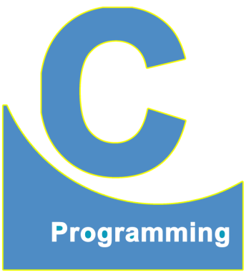
End of Lecture 25
For any queries mail us @: scalive4u@gmail.com
Call us @ : 0755-4271659, 7879165533
Thank you

